Slide 1
Precipitation
Venkat Lakshmi
University of Virginia

Slide 2
Precipitation
Largest Principal component in the Hydrological cycle
If you do not have precipitation, there is no hydrology – Job security
There are not many hydrology publications for Saudi Arabia!
Measurement of precipitation is impossible – it could be raining at your house and not at your neighbor…Impossible to characterize precipitation
Referring to gauge observations as ground truth is misleading at best, incorrect at worst…Truth – You can’t handle the truth [Few Good Men, Jack Nicholson]
The only variable in surface hydrology that is a true characterization is streamflow and precipitation is input to models that simulate streamflow
Larger time accumulation and larger spatial extents are always more accurate – example monthly 10km is much easier than hourly 1km
Annual/Decade/Century – for large river basin, Precipitation equals Streamflow

Slide 3
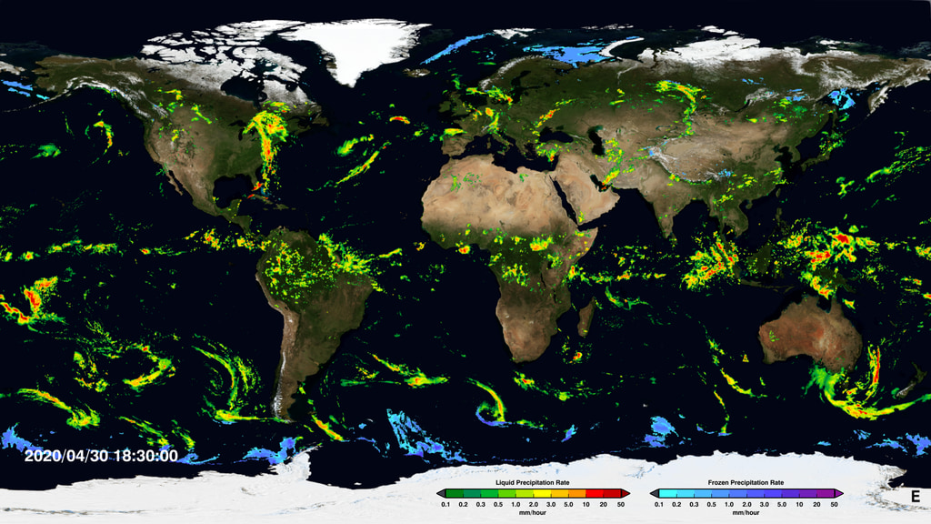
IMERG Multi-Satellite Products Across Two Decades
George J. Huffman(1), David T. Bolvin(1,2),
Dan Braithwaite(3), Kuolin Hsu(3), Robert Joyce(4,5),
Christopher Kidd(1,6), Eric Nelkin(1,2), Soroosh Sorooshian(3),
Jackson Tan(1,7), Pingping Xie(5)
(1) NASA/GSFC Earth Sciences Division – Atmospheres
(2) Science Systems and Applications, Inc.
(3) Univ. of California Irvine
(4) Innovim
(5) NOAA/NWS Climate Prediction Center
(6) Univ. of Maryland / ESSIC
(7) Univ. Space Res. Assoc.
george.j.huffman@nasa.gov
See https://svs.gsfc.nasa.gov/cgi-bin/details.cgi?aid=4285
U.S. Gov’t. Work

Slide 4
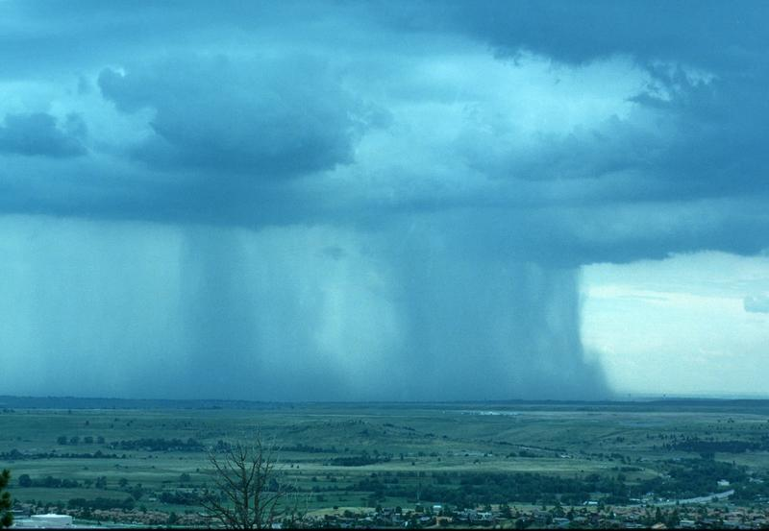
1. INTRODUCTION – Rain is easy to measure, hard to analyze
The physical process is hard
to represent:
• Rain is generated on the microscale
• Rhe decorrelation distance/time is short
• Point values only represent a small area & snapshots only represent a short time
• A finite number of samples causes problems
Image courtesy of the University Corporation for Atmospheric Research

Slide 5
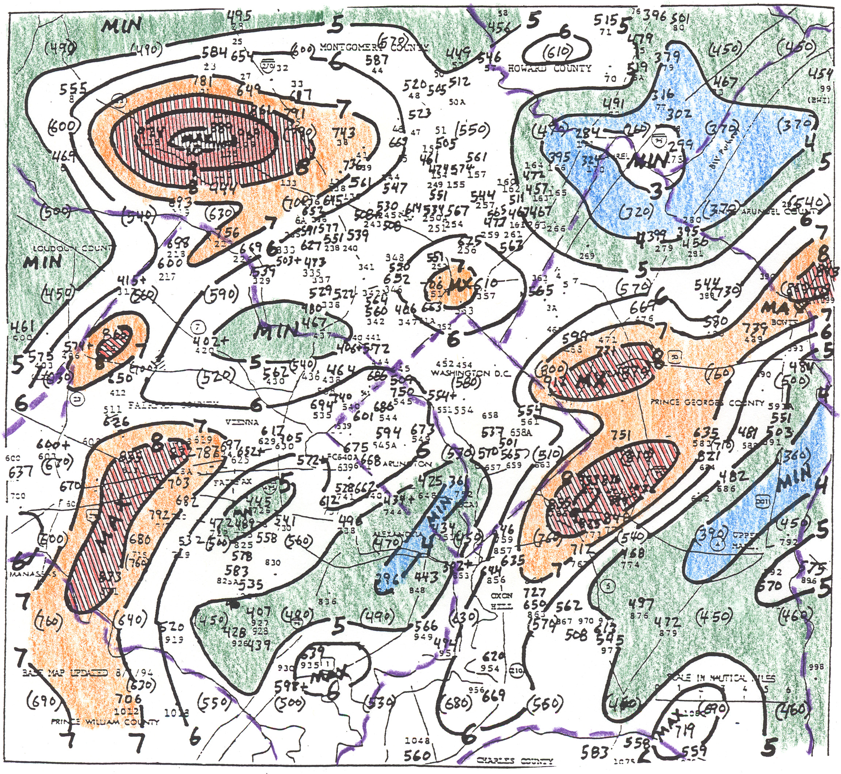
1. INTRODUCTION – Decorrelation distance
Rainfall for DC area, July 1994
• Convective rain has very short correlation distances – even for a month

Slide 6
INTRODUCTION – Instrumental errors….Every measurement has errors!
All instruments have characteristic errors:
• Raingauge
wind losses
splashing
evaporation
side-wetting
interpolation
• Radar
raindrop population changes
anomalous propagation
beam blockage by surface features
sidelobes
• Satellite
physical retrieval errors
beam-filling errors
time-sampling
• Numerical prediction models
computational approximations
initialization errors
errors in other parts of the computation

Slide 7
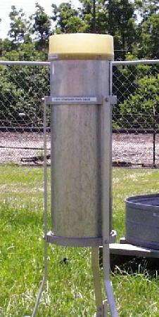
Rain gauge
In its simplest form, an 8-inch Standard Rain Gage is an open mouth can with straight sides. Every climatological station in the "A" Network must be equipped with a SRG. Even though the SRG is preferred, the 11-inch plastic gage is an acceptable substitute in stations other than those in the "A" Network.
http://www.weather.gov/iwx/coop_8inch

Slide 8


Rain Gauge Data
In the United States, rain gauge data for NWS operations come from several different sources:
. Federal & State Wildland Fire Programs --- over 2000 rain gages
. USGS --- 1,500+ rain gages
. USACE --- 1600+ rain gages
. NWS --- 200+ rain gages
. 100+ other DCS Platform operators (USBR, TVA etc.)
Other:
. State and local government funded agencies (Mesonets)
. Automated Surface Observing System
. Cooperative rain gauge network
. Other NWS supported gauges (IFLOWS, ALERT etc.)
Spatial resolution : Non-uniform
Temporal resolution : hourly and daily (few 1 min. gauges)
Jeff McCollum

Slide 9
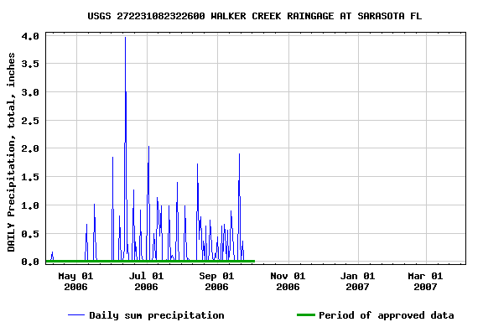
Time series from a rain gauges operated by USGS
The data was obtained from http://waterdata.usgs.gov/nwis/sw for the Walker Creek Raingauge at Sarasota FL
The data can also be downloaded as simple text files

Slide 10
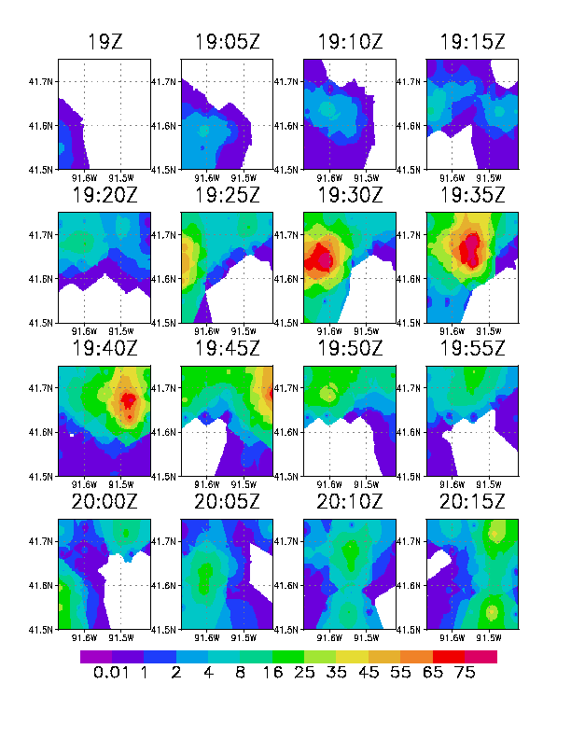
Gauge Time Sequence
5 km and 5-minute sampling allows for detailed evolution of rain system
Rain rate (mm/h)
Jeff McCollum

Slide 11
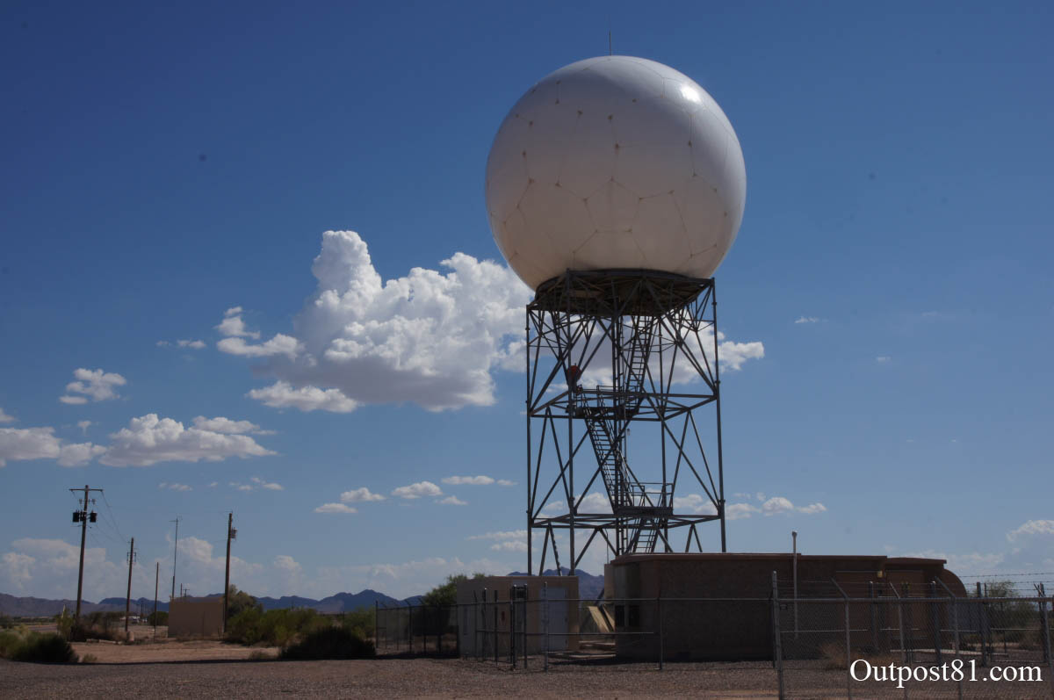

RADAR

Slide 12
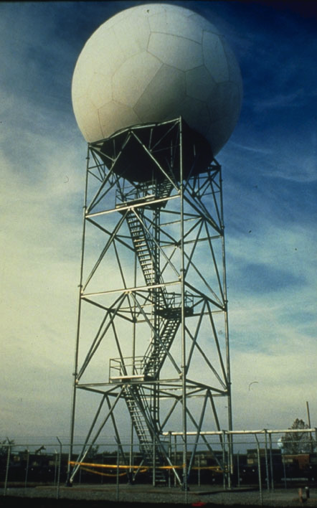
NEXRAD (Next Generation Weather Radar system)
150+ operational NEXRAD stations spread all over the US and selected overseas location
Maximum range of the NEXRAD radar is 250 nautical miles
Many of the radars will/have dual polarization, i.e., transmit and receive in vertical polarization in addition to the horizontal polarization. This helps with detection of frozen precipitation
Applications include sever weather and flash flood warning, air traffic safety, water resource management, agriculture and forests
Radar Operations Center (ROC) is based in Norman, Oklahoma

Slide 13
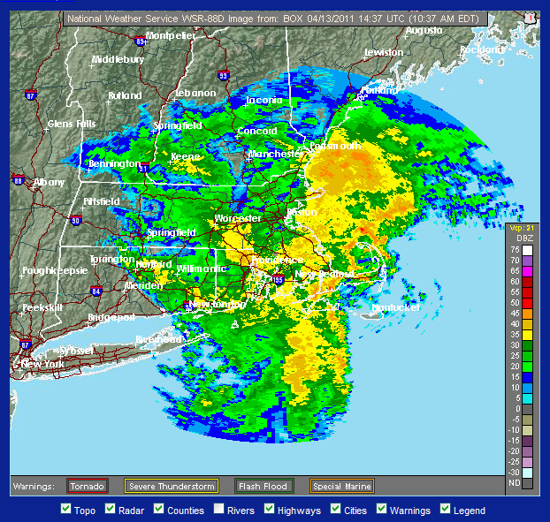
Radar Rainfall Relationship
Most algorithms use the expression
Z = a R^{b}
Termed the Z-R relationship with a=300 and b=1.4; Z=radar reflectivity and R = Rain Rate
Z and R vary with type of storm and climatic region

Slide 14
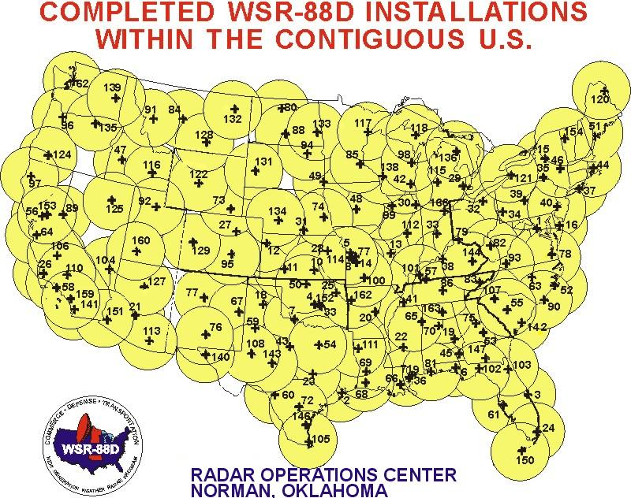

Slide 15
NEXRAD data
Level II data includes reflectivity, mean radial velocity and spectrum width
From Level II data 41 Level III meteorological analysis products are produced
Data can be obtained from NCDC (NOAA Climatic Data Center)
Details about the products can be obtained from https://www.ncei.noaa.gov/access/metadata/landing-page/bin/iso?id=gov.noaa.ncdc:C00708

Slide 16
NEXRAD data
A number of tools are provided by NCDC to visualize and convert the data into formats like Shapefile, Arc/Info ASCII grid (eg. Java NEXRAD viewer)

Slide 17
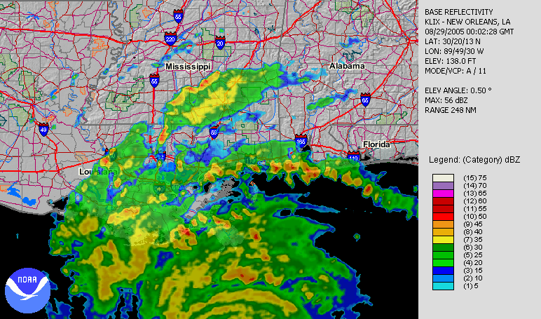
NEXRAD (Hurricane Katrina)
http://www.ncdc.noaa.gov/oa/radar/jnx/jnt-katrina.php

Slide 18
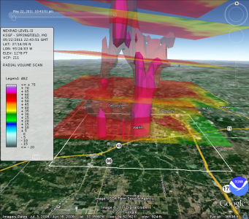
Visualization of NEXRAD Reflectivity sweeps and derived isosurfaces in Google Earth for the May 22, 2011, Joplin, MO tornado. The image was generated with the NOAA Weather and Climate Toolkit and Google Earth. (http://www.ncdc.noaa.gov/data-access/radar-data)

Slide 19
1. INTRODUCTION – Instrumentation strong points
Knowledge of precipitation is key to a wide range of users
Data sources have recognized strengths:
• microwave imagers good instantaneous results
• geo-IR good sampling
• satellite soundings some info. In cold-surface conditions
• precipitation gauge near-zero bias
• model complete coverage and "physics"
Different data sources are best in different regions
All have bigger errors in
• mountains
• snowy/icy regions

Slide 20
1. INTRODUCTION – But …
Instruments have characteristic errors:
• raingauge
wind losses
splashing
evaporation
side-wetting
interpolation
• radar
raindrop population changes
anomalous propagation
beam blockage by surface features
sidelobes
• satellite
physical retrieval errors
beam-filling errors
time-sampling
• numerical prediction models
computational approximations
initialization errors
errors in other parts of the computation
Sensor-specific strengths and limitations
infrared microwave
latency 15-60 min 3-4 hr
footprint 4-8 km 5-30+ km
interval 15-30 min 12-24 hr
(up to 3 hr) (~3 hr)
“physics” cloud top hydrometeors
weak strong
• additional PMW issues over land include
• scattering channels only
• issues with orographic precipitation
• estimates not accurate over snow (or sea ice)

Slide 21
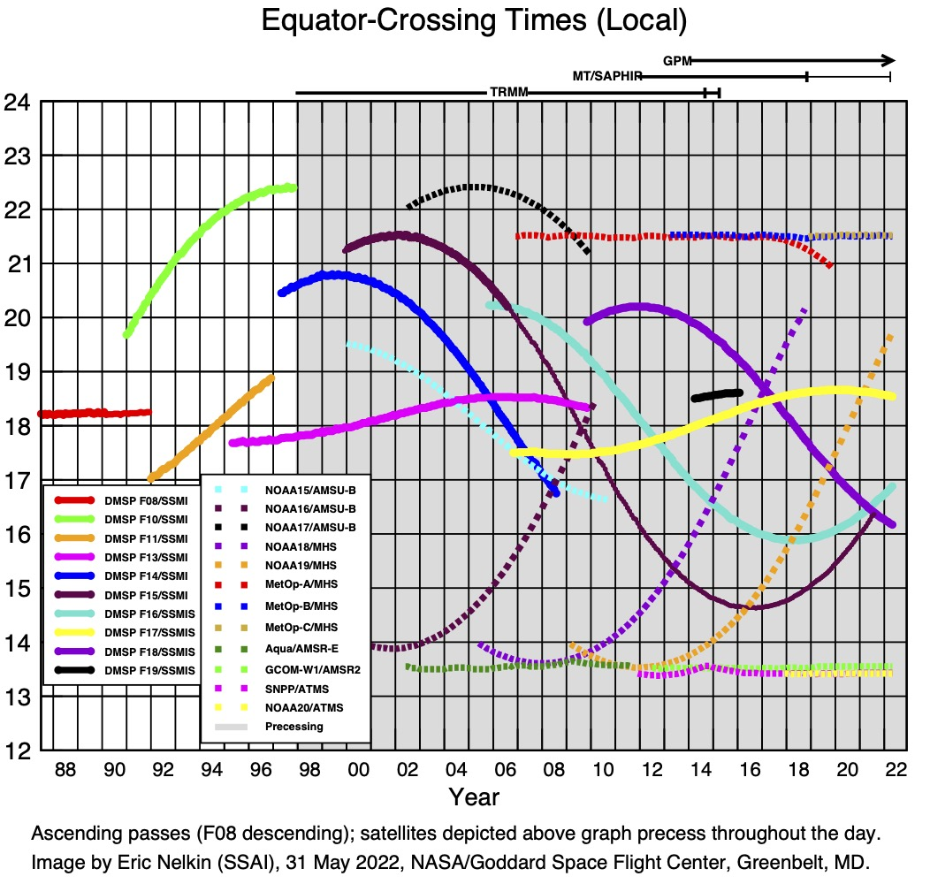
1. INTRODUCTION – History
Early 1970’s sensors include
• ESMR
• SMMR
• MSU
DMSP F08 SSMI considered the first “real” PMW
• unclassified data drove a boom in PMW research
• highly valued in the civilian community
• conical-scan design provides polarization and constant foot- print size
Cross-track scanning sounders used, but lack these advantages
Local Time (h)

Slide 22
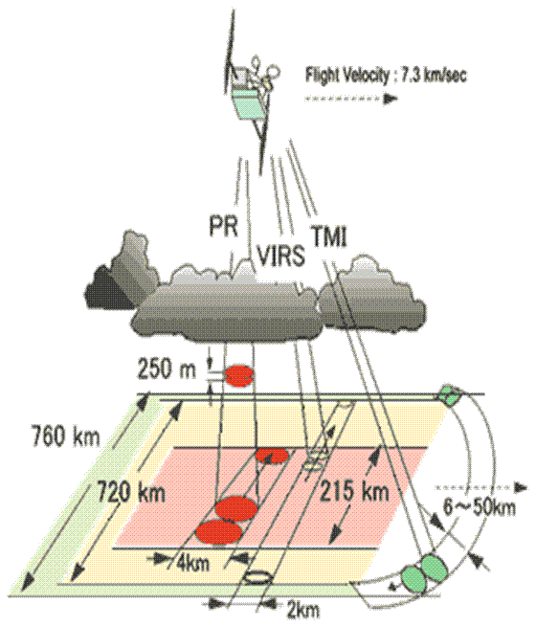
TRMM
Tropical Rainfall Measuring Mission
Joint NASA JAXA mission
Launched November 1997

Slide 23
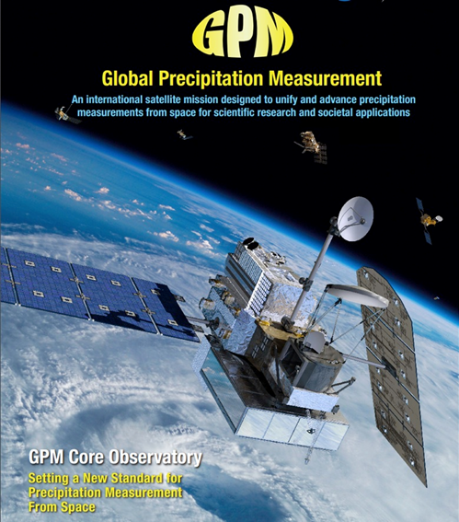
The GPM Core Observatory carries two advanced instruments that allow us to view precipitation (rain, snow, ice) in new ways and serve as a connector between the GPM Core and measurements taken on other partner satellites
GPM Microwave Imager (GMI): 10-183 GHz
13 channels provide an integrated picture of the energy emitted by precipitation, including light rain to heavy rain to falling snow. Like an X-Ray.
Dual-frequency Precipitation Radar (DPR): Ku-Ka bands
Two different radar frequencies that measure precipitation in 3-D throughout the atmospheric column. Like a CT Scan. Built by JAXA [13.6 and 35.5 GHz]
Non-Sun-Synchronous orbit at 65º inclination (Arctic to the Antarctic Circle) at 407 km
Notes:
Gail

Slide 24
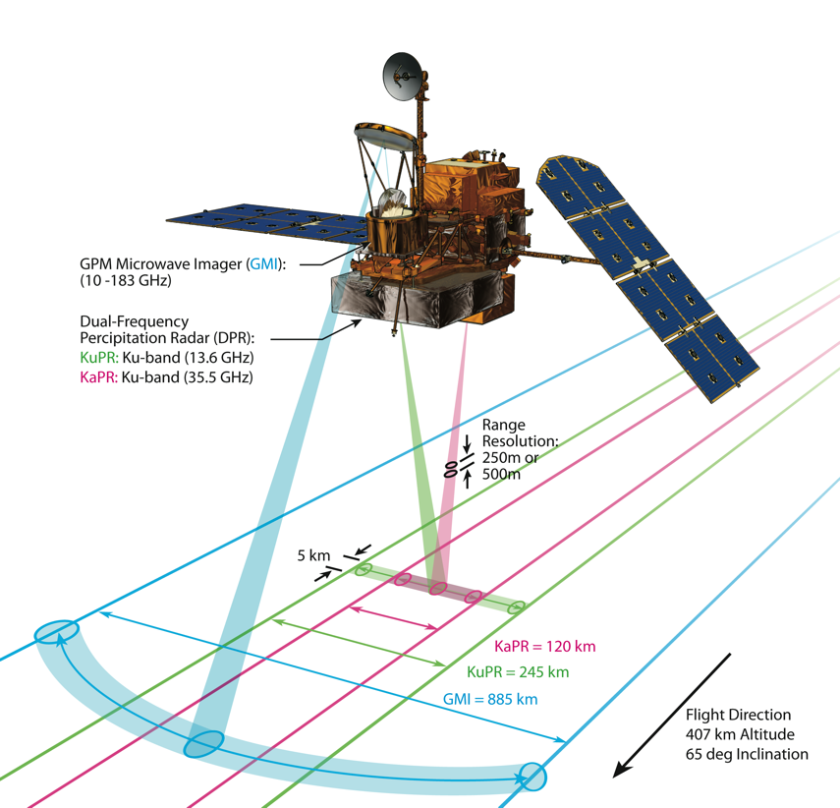
Core Observatory Geometry and Instruments
Orbit: 407 km; 65 deg inclin.; 3-year life, 5+ year fuel
GPM Microwave Imager (GMI)
Passive microwave radiometer with hot and cold calibration, includes novel calibration engineering
Provides measurements of precipitation (rain and snow) intensity and distribution over wide swath (880 km)
High spatial resolution (down to ~5km footprints)
166 Kg, 162 W, 34.9 Kbs Science,1.2 m diameter reflector
Dual-frequency (Ku-Ka band) Precipitation Radar (DPR)
KuPR similar to TRMM, KaPR added for GPM
Provides three-dimensional measurements of precipitation structure, precipitation particle size distribution (PSD) and precipitation intensity and distribution
High spatial resolution (5km horizontal; 250m vertical)
 | KuPR | KaPR
Frequency | 13.597 , 13.603 GHz | 35.547 , 35.553 GHz
Min. detectable rainfall rate | 0.5 mm/hr | 0.2 mm/hr
Data Rate | < 109 kbps | < 81 kbps
Mass | < 472 kg | < 336kg
Power Consumption | < 446 W | < 344 W
Size | 2.5 × 2.4 × 0.6 m | 1.2 × 1.4 × 0.7 m
GMI Frequencies | GMI Polarizations
10.65 GHz | V/H
18.7 GHz | V/H
23.8 GHz | V
36.5 GHz | V/H
89 GHz | V/H
166 GHz | V/H
183 GHz | Va/Vb (±3 & ±7)
Notes:
As a reminder, these are the specs for the Core Observatory. They directly feed into meeting science objectives.

Slide 25
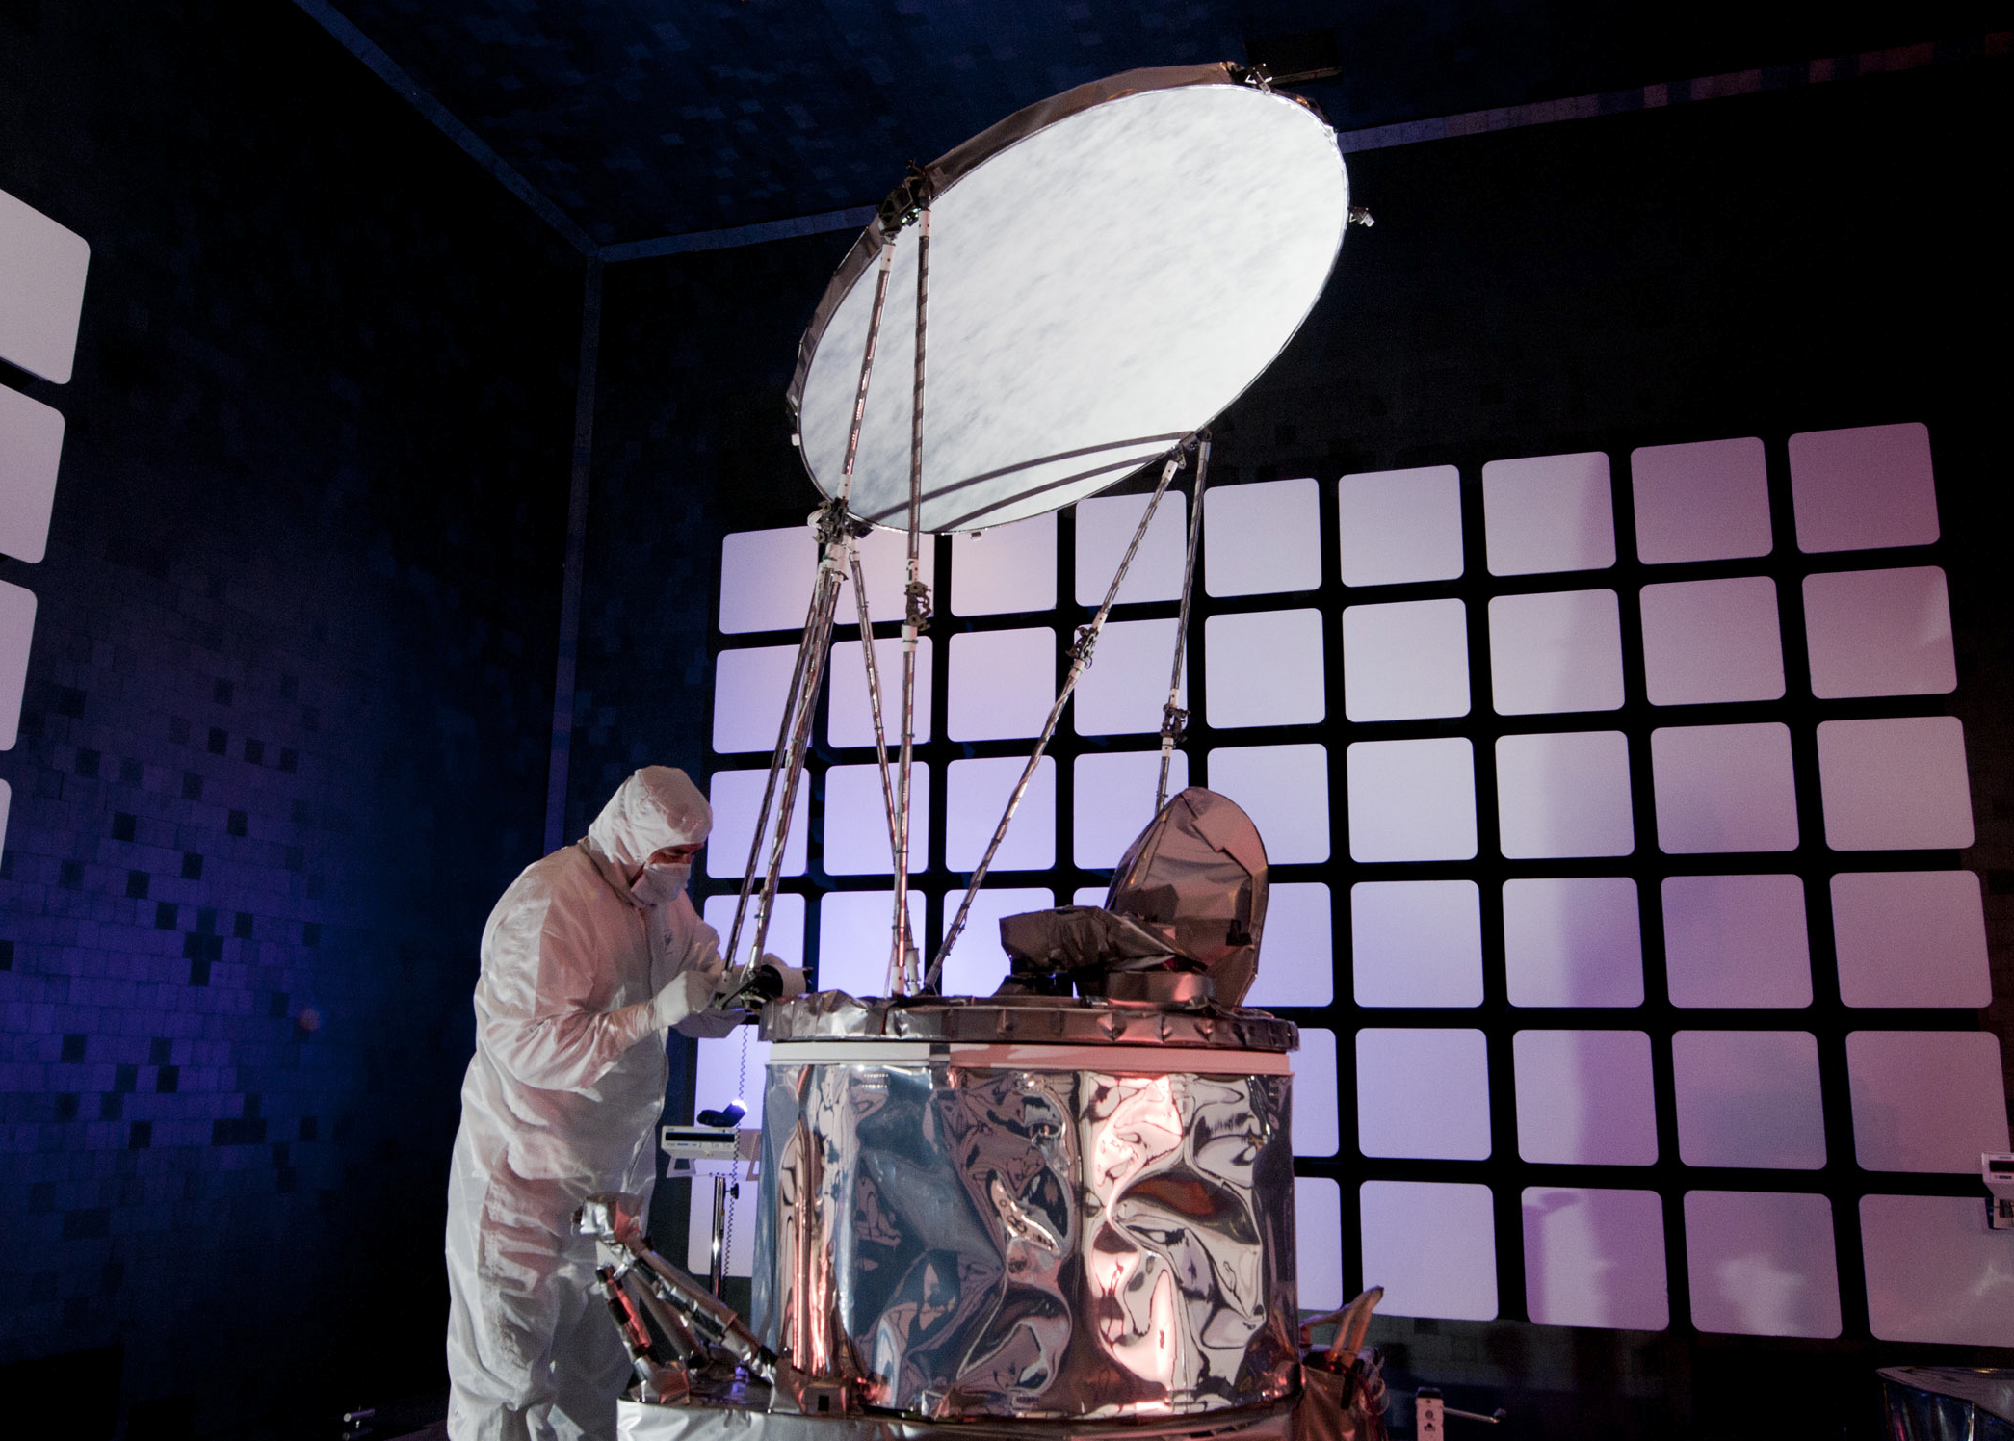
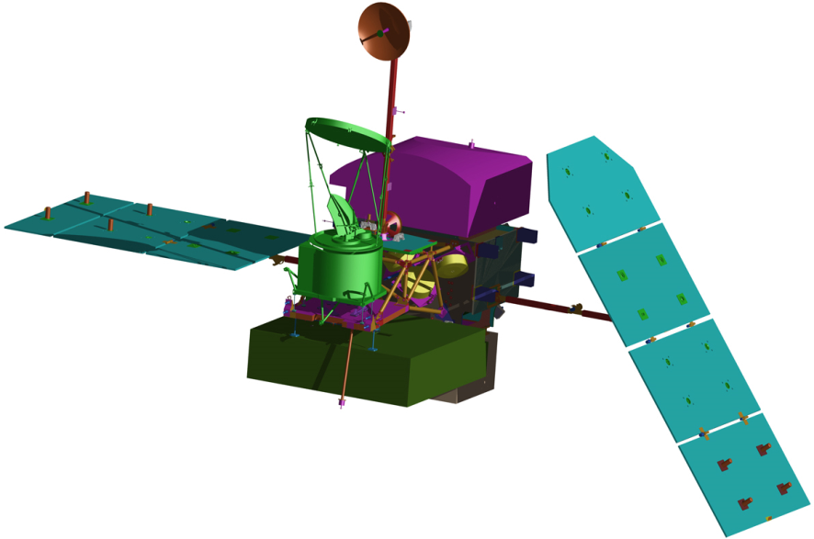
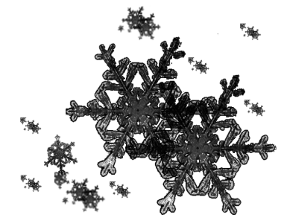
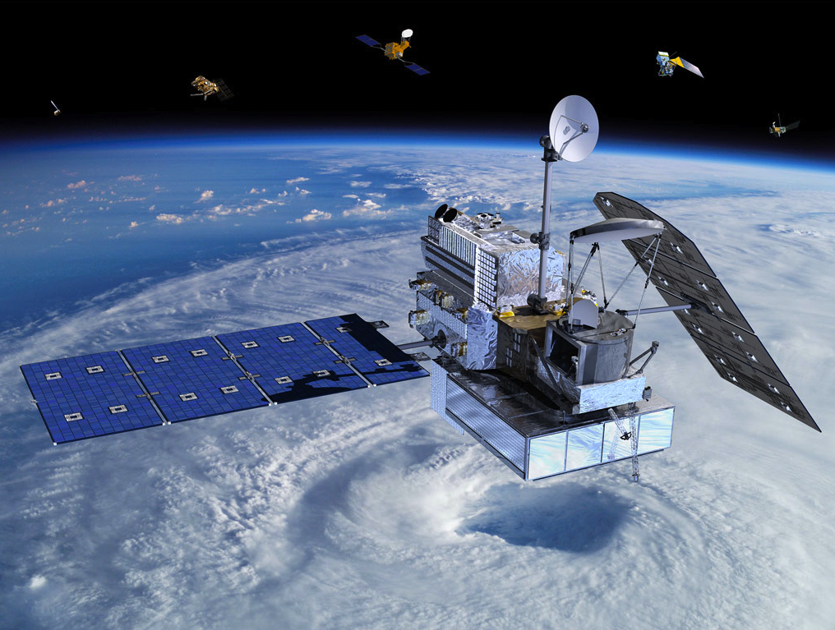
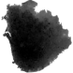

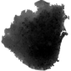

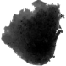

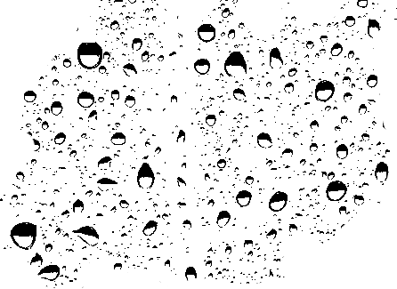


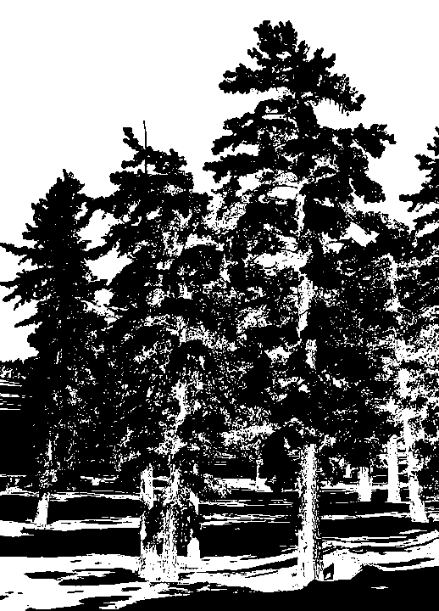
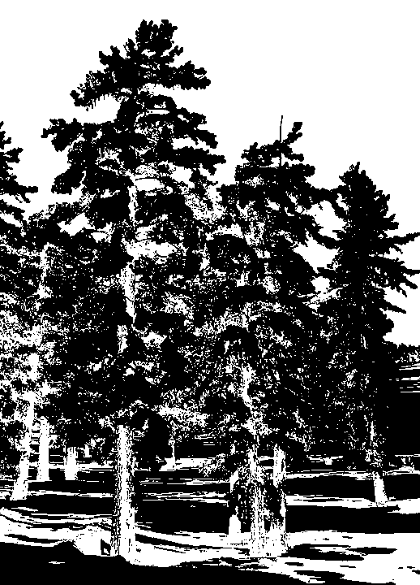

GPM Microwave Imager
Different types of precipitation emit energy at different frequencies (GHz). The GMI passively absorbs this energy (and other competing signals) and can decipher what is happening in the cloud (sort of like an x-ray)
GMI Testing at Ball Aerospace (Colorado, USA)
Courtesy of Ball
Water vapor:
absorption/
Emission
Ice: scattering
Courtesy of Ball
Rain: scattering, emission/
absorption
Surface: scattering, emission/absorption

Slide 26
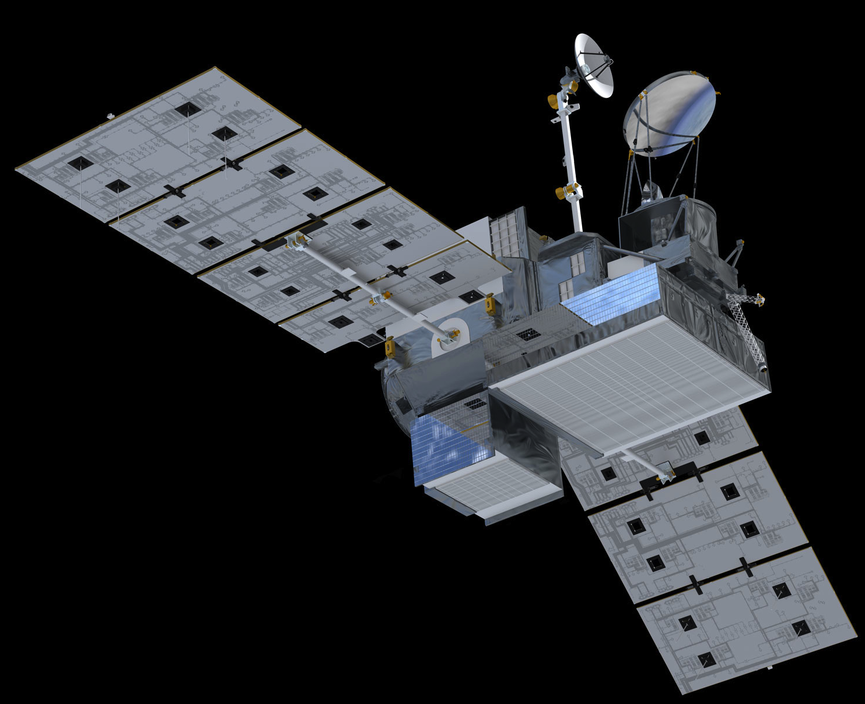
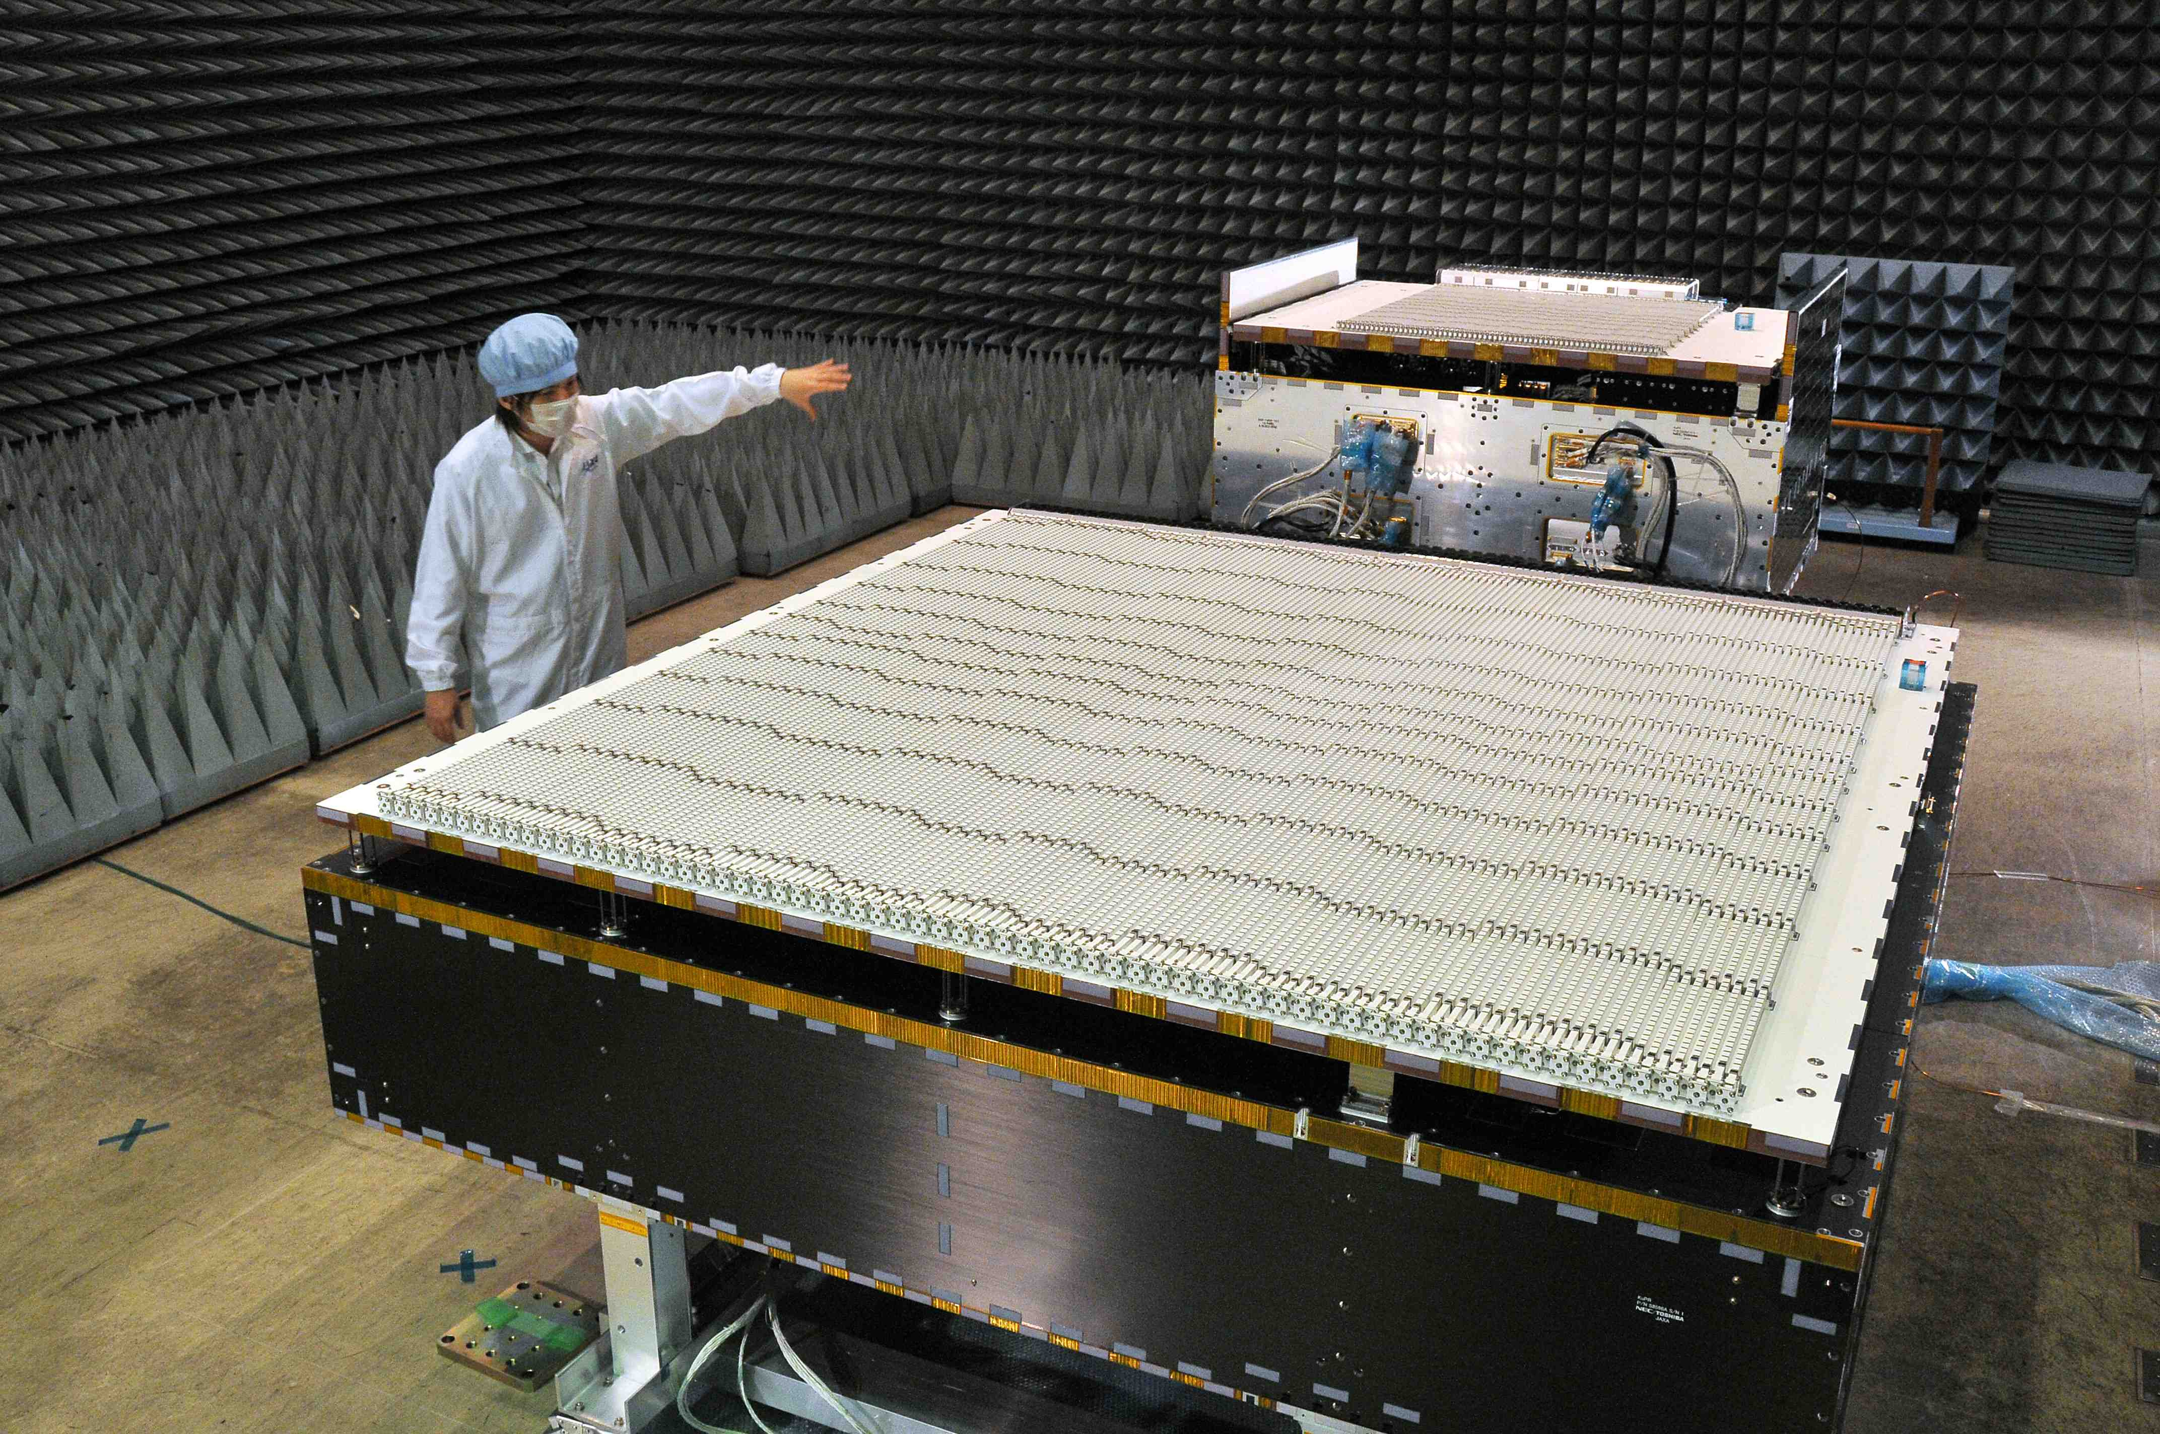
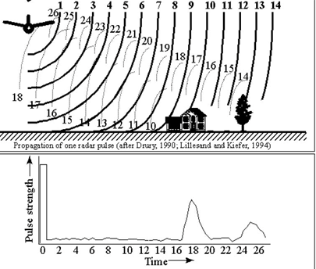
Dual-frequency Precipitation Radar
The DPR sends out two different frequencies at 35 GHz and 13.6 GHz and can determine the size and distribution of rain, snow, and ice from the strength of the returning signal
By using two frequencies it enables us to better understand particle distribution and microphysics, which is very important for improving estimates of rain rate on the surface
Takes 3D data like a CT scan.
DPR development at JAXA
***Link to Radar/radiometer Animation
Courtesy of JAXA

Slide 27
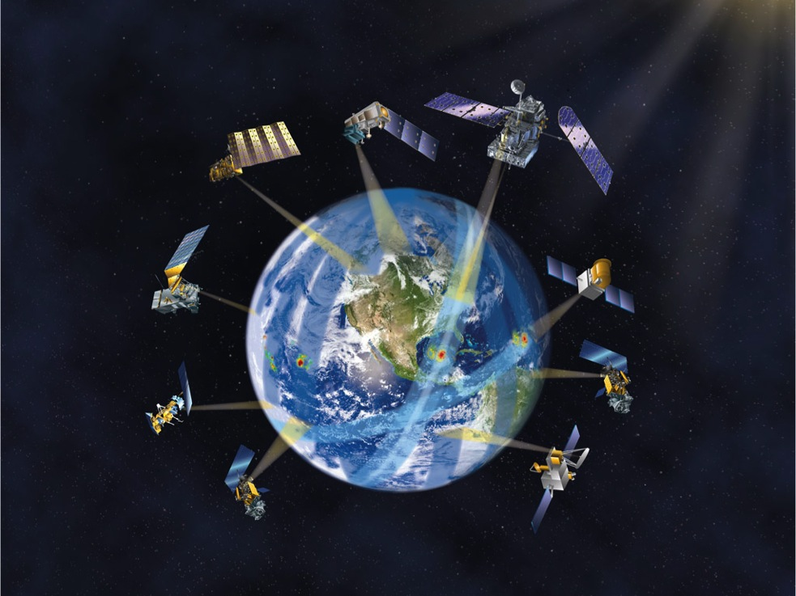

GPM Constellation Concept
GPM Core Observatory
(NASA/JAXA, 2014 )
DPR (Ku & Ka band)
GMI (10-183 GHz)
65º Inclination
407 km altitude
5 km best footprint
0.2 – 110 mm/hr and snow
Lifetime: 3, 5, 15 years
Suomi NPP
(NASA/NOAA)
MetOp B/C
(EUMETSAT)
JPSS-1 (NOAA)
Megha-Tropiques (CNES/ISRO)
NOAA 18/19 (NOAA)
TRMM
(NASA/JAXA)
DMSP F17/F18/F19/F20
(DOD)
GCOM-W1 (JAXA)
Next-Generation Unified Global Precipitation Products Using GPM Core Observatory as Reference
Precipitation rates everywhere in the world every three hours
27
Notes:
GPM establishes a new milestone for international cooperation in Earth science satellite observations. NASA and JAXA are launched the GPM Core Observatory that is designed to work with, and anchor, the constellation of satellites and ground systems from the partner agencies of Japan, Europe, India, as well as U.S. agencies such as NOAA. It will seamlessly combine all the measurements into a single global precipitation data set every 3 hours.
Yellow for launched assets, white for to be launched assets.

Slide 28
WHAT REMOTE SENSORS “SEE”
The physical setting
Solid hydrometeors
Visible Cloud
∗
∗
∗
∗
∗
∗
∗
∗
∗
∗
∗
∗
∗
∗
∗
∗
0°C
Melting level
Liquid hydrometeors
Rain shaft
Huffman 10/10

Slide 29
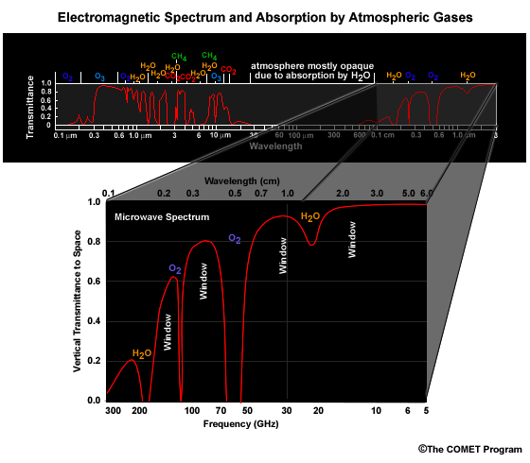
WHAT REMOTE SENSORS “SEE” (cont.)
Only a few bands in the electromagnetic spectrum are used for precipitation retrieval from satellite
visible - possible,
but not used
operationally
passive infrared (IR)
passive microwave
- emission channels
passive microwave
- scattering channels
active microwave
- radar
Huffman 2/10
Huffman 10/10

Slide 30
WHAT REMOTE SENSORS “SEE” (cont.)
Passive infrared senses the cloud top
∗
∗
Upwelling energy
emitted by the last
τ=1 in the column
∗
∗
∗
∗
∗
∗
∗
∗
∗
∗
∗
∗
∗
∗
0°C
Most of the upwelling
energy from below is
absorbed by the
material that yields
the last unit of optical
depth (τ) along the
sensor’s line of sight
Huffman 10/10

Slide 31
WHAT REMOTE SENSORS “SEE” (cont.)
Passive microwave at “low” frequencies senses
emission by liquid hydrometeors
∗
∗
∗
∗
∗
∗
Upwelling energy
emitted by cloud
water and liquid
hydrometeors
∗
∗
∗
∗
∗
∗
∗
∗
∗
∗
0°C
Upwelling energy
emitted by surface
Huffman 10/10

Slide 32
WHAT REMOTE SENSORS “SEE” (cont.)
Passive microwave at “high” frequencies senses
scattering by ice hydrometeors
∗
∗
Scattering by
ice hydrometeors
∗
∗
∗
∗
∗
∗
∗
∗
∗
∗
∗
∗
∗
∗
Upwelling energy
emitted by surface,
cloud water, and
liquid hydrometeors
0°C
The emission from
liquid is considered
a given; scattering
Is considered the
useful signal
Huffman 10/10

Slide 33
WHAT REMOTE SENSORS “SEE” (cont.)
Radar – active microwave – provides range-resolved
information about all hydrometeors
∗
∗
∗
∗
∗
Back-scattered
signal from
hydrometeors
∗
∗
∗
∗
∗
∗
∗
∗
∗
∗
∗
0°C
Outward-bound
radar pulse; very
short and energetic
Each location along
the back-scattered
signal contains data
about one small volume
of hydrometeors
Huffman 10/10

Slide 34
Passive Radiometer Imagery
T_{B}
= Brightness
Temperature
T_{CB}
T_{S}
Surface temperature and emissivity

Slide 35

Modeling Passive Imagery
Radiometer
Forward scattering
θ
T_{B}
Incident
Radiation
T_{CB}
Scattered
Radiation
Absorption,
Emission
*
*
Backward scattering
*
*
*
*
*
*
*
*
*
*
*
Incident
Radiation
Planar Stratified Layers
T_{S}
h = 0
Surface temperature and emissivity

Slide 36
Brightness temperature (T_{B})
At microwave frequencies, electromagnetic radiation intensity is proportional to temperature.
Rayleigh-Jeans approximation:
ν=f : Frequency
K : Boltzmann’s constant
c : Velocity of light
T : Temperature
Appropriate for freq ~< 150 GHz,
Down looking radiometers
Planck’s Law:
Appropriate for all freq,
up & down looking radiometers
First-Order Planck’s Law in Radiative Transfer:
Use Rayleigh-Jeans, except for T_{CB}
Within 0.15 K of full Planck
to 874 GHz, down looking

Slide 37
4. IMERG (Integrated Multi-satellitE Retrievals for GPM) – Box Diagram
The flow chart shown is for
the final product
• institutions are shown for
module origins, but
• package is an integrated system
• “the devil is in the details”
• (near-)RT products use a cut-down of this processing
• three steps:
• calibrate
• propagate
• augment
UC Irvine
GSFC
CPC
Compute even-odd IR files
(at CPC)
3
IR Image segmentation
feature extraction
patch classification
precip estimation
9
Receive/store
even-odd IR
files
1
Compute IR
displacement vectors
4
Build IR-PMW precip calibration
10
Import PMW data;
grid; calibrate; combine
2
Forward/
backward
propagation
5
Recalibrate
precip rate
11
Import mon. gauge;
mon. sat.-gauge
combo.;
rescale short-interval
datasets to monthly
12
8
7
Apply Kalman
filter
Build Kalman
filter weights
Post-RT
RT
13
prototype6
Apply climo. cal.

Slide 38
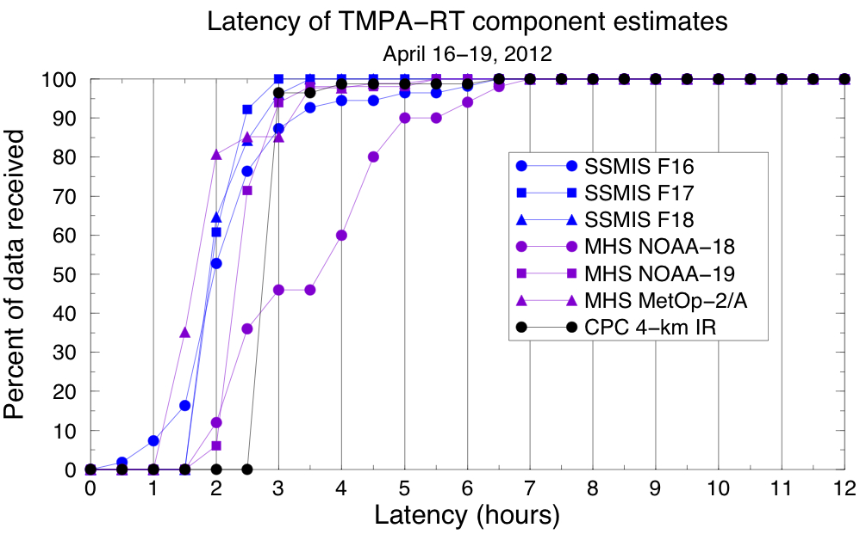
4. IMERG – Multiple Runs
Multiple runs serve different users’ needs for timeliness
• More delay usually yields a better product
Early – first approximation;
flood, now-casting users
• Current input data latencies at PPS support ~4-hr delay
• Truly operational users (< 3 hr) not well-addressed
Late – wait for full multi-satellite; crop, flood, drought analysts
• Driver is the wait for microwave data for backward propagation
• Delay of ~12 hr
Final – after the best data are assembled; research users
• Driver is precipitation gauge analysis
• GPCC gauge analysis is finished ~3.5 months after the month
graphic courtesy of E. Nelkin (SSAI; GSFC Code 612))

Slide 39
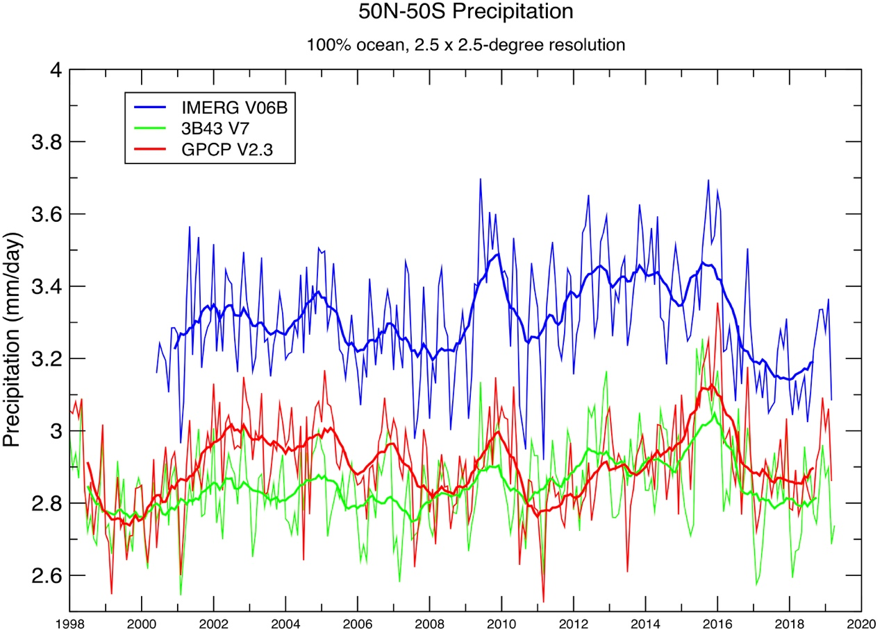
2. Early Results – Ocean (50ºN-S) Precipitation Timeseries (1/2)
V06 Final Run starts June 2000
V06 is higher than 3B43 (TMPA) and GPCP over ocean
TRMM-era IMERG has a strong semi-annual signal
• GPM-era IMERG and 3B43 dominated by the annual cycle
Interannual variation
• Has similar peaks/troughs for all datasets
• GPCP (passive microwave calibration) lags phase of 3B43 (through 2013), IMERG (both PMW/radar calibration)
• After September 2014, 3B43 (PMW calibration) matches GPCP phase
50ºN-S, 100% ocean, 2.5ºx2.5º grid
Precipitation Averages — 50ºN-S, 100% ocean, 2.5ºx2.5º grid
E. Nelkin (SSAI; GSFC)
U.S. Gov’t. Work

Slide 40
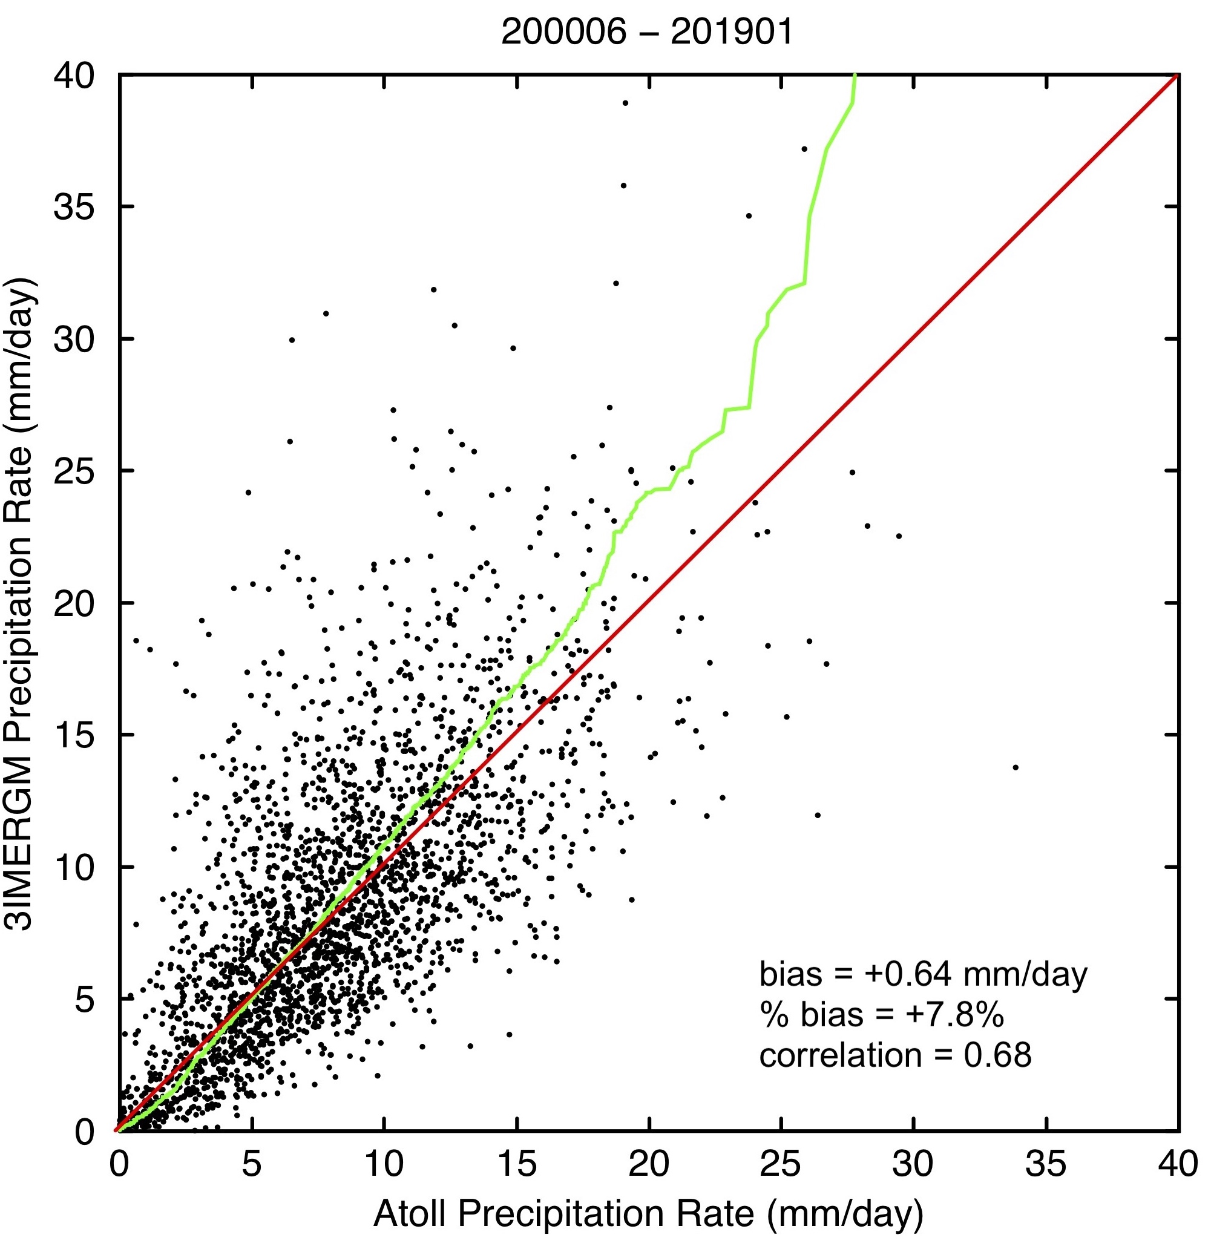
2. Early Results – IMERG Final, Monthly for Atolls
Monthly accumulations for tropical Pacific atolls
• Pacific Rainfall Database (PACRAIN)
• Match of gauge to encompassing 0.1º grid box
• All useful months
• stations have various periods of record (potentially changing the regions sampled)
• 38 “good” atolls, averaging ~11/month
• bias varies with precip rate
• IMERG under-(over-)estimates at low(high) rates
• atoll gauges lack undercatch correction
• likely ~5-10%, so overall IMERG bias is (amazingly) good, but rate biases remain
D.Bolvin (SSAI; GSFC)

Slide 41
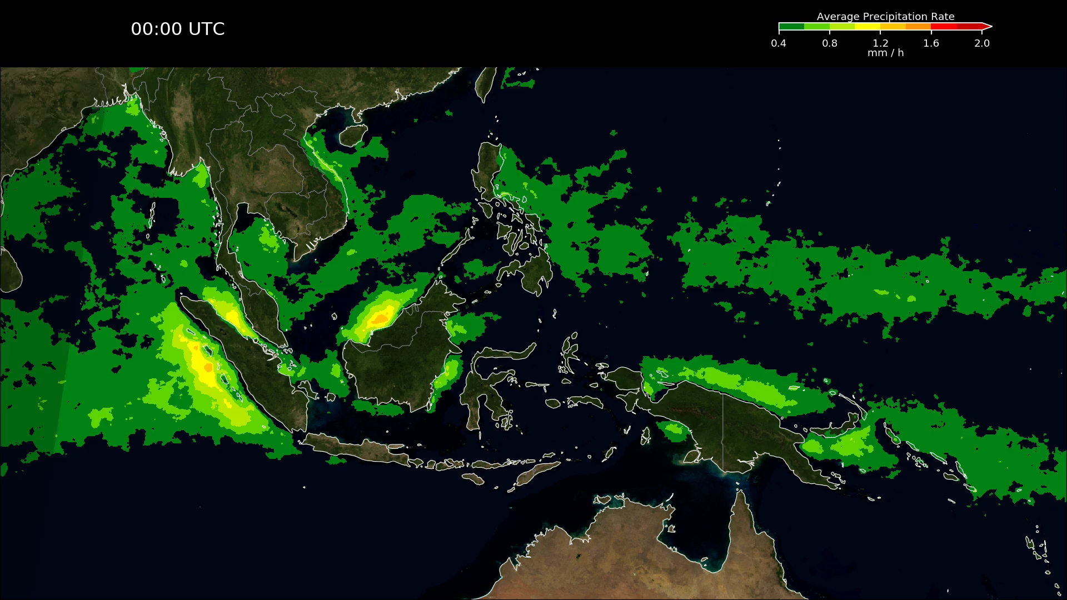
2. Early Results – Final Run, September-November Diurnal Cycle, Maritime Continent
Average September-November for 2001 to 2018, Final Run
• day/night shading
• Blue Marble land
• smoothed in space and time
• even 18 years of seasonal data still has lumps
Reminiscent of IMERG V05, but
• less “flashing” due to inter-satellite differences and morphing
• better data coverage at higher latitudes (not seen here)
J. Tan (USRA; GSFC)
Reminiscent of TMPA, but
• more detailed, broader spatial coverage
• no interpolations between the 3-hourly times
• less IR-based precip used (which tends to have a phase lag)
U.S. Gov’t. Work

Slide 42
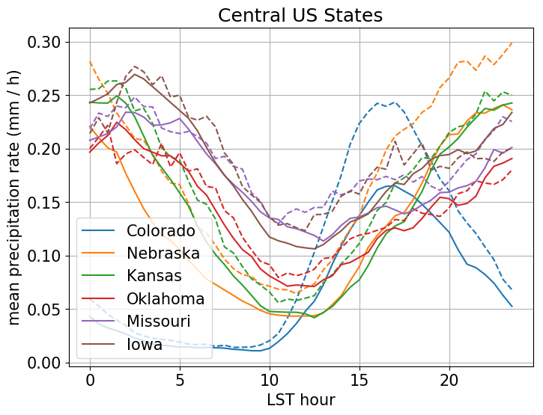
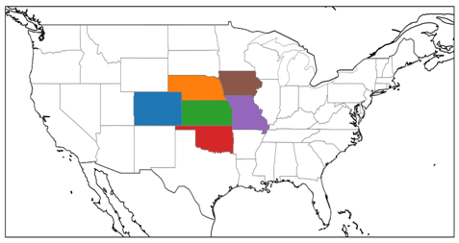
2. Early Results – Final Run, June-August Diurnal Cycle in Central U.S. (GPM Era)
Average June-August for 2014 to 2018 (5 summers) for 6 states, Final Run
Compared to Multi-Radar Multi-Sensor (MRMS, dashed), Final (solid) shows:
• lower averages (despite use of gauge data)
• lower amplitude cycle in Colorado
• higher amplitude cycle in Iowa
• very similar curve shapes, peak times
This version of MRMS only starts in 2014, so an extended comparison requires different data
IMERG-Final – solid
MRMS – dashed
J. Tan (USRA; GSFC)
U.S. Gov’t. Work

Slide 43
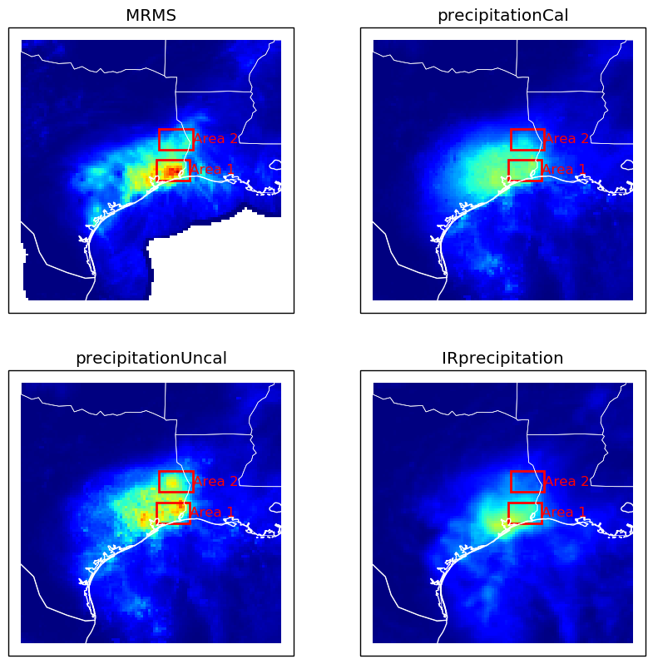
S4. Early Results – Hurricane Harvey, 25-31 August 2017, IMERG and MRMS (1/2)
Harvey loitered over southeast Texas for a week
• MRMS considered the best estimate
• some questions about the details of the gauge calibration of the radar estimate
• over land
• Un-calibrated (just the intercalibrated satellite estimates) under(over)-estimated in Area 1(2)
• should be similar to Late Run
• Calibrated (with gauge adjustment) pulls both areas down
• microwave-adjusted PERSIANN-CCS IR has the focus too far southwest
J. Tan (USRA; GSFC)
U.S. Gov’t. Work

Slide 44
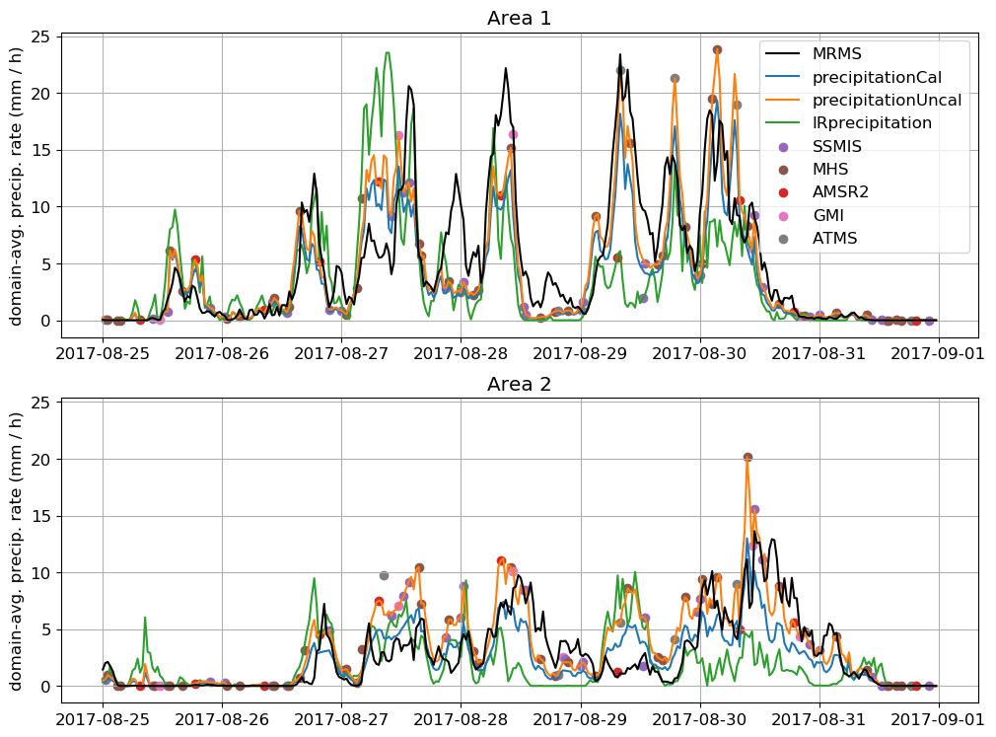
S4. Early Results – Hurricane Harvey, 25-31 August 2017, IMERG and MRMS (2/2)
IMERG largely driven by microwave overpasses (dots)
• except duplicate times
• not just time interpolation
• systems move into / out of the box between overpasses
• satellites show coherent differences from MRMS
• microwave only “sees” the solid hydrometeors (scattering channels), since over land
• IR looks at Tb within “clustered” data
• both are calibrated to statistics of time/space cubes of data
• Cal is basically ( Uncal x factor )
• short-interval differences show some cancellation over the whole event
• but several-hour differences can be dramatic
J. Tan (USRA; GSFC)
U.S. Gov’t. Work

Slide 45
HOW GOOD? (cont.)
The problem of estimating errors for individual grid boxes is challenging
• the theory is not well-developed
• necessary data are not always available from the input data sets
• a first approximation is available for GPCP and TRMM monthly estimates
• a legitimate daily and shorter error scheme is still under development
• a full treatment must address the algorithm and sampling sources of error
• goals:
- relate random errors across ranges of time/space scales
- estimate bias
Huffman 10/10

Slide 46
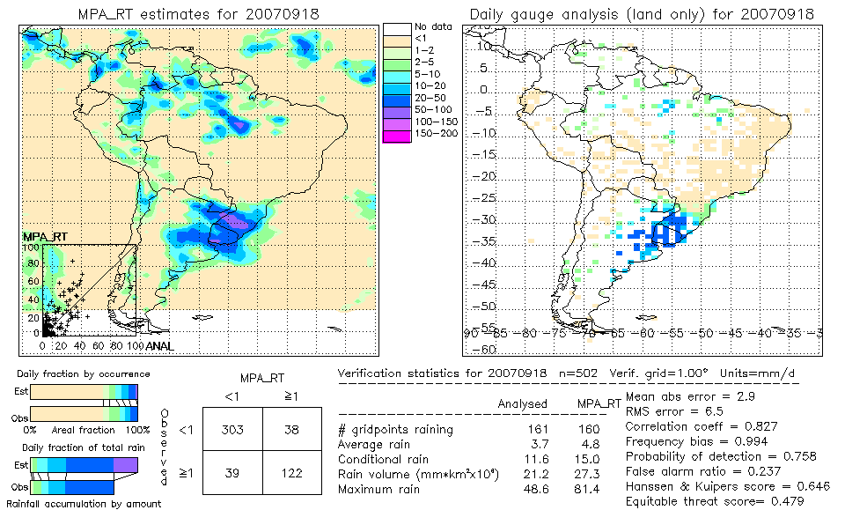
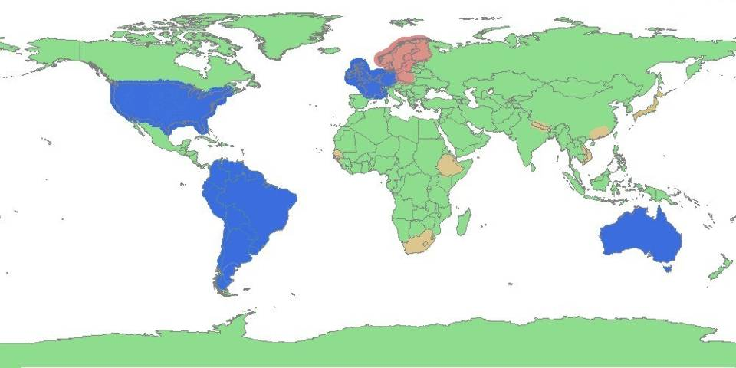
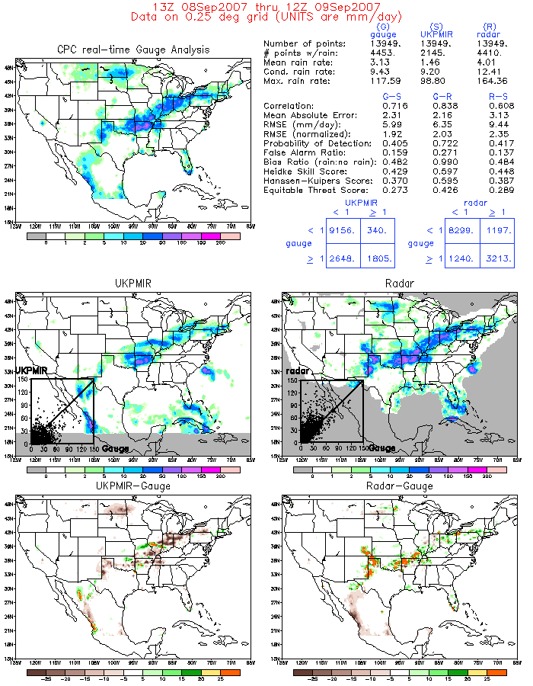
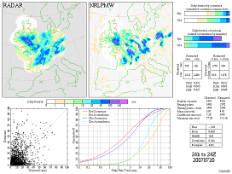
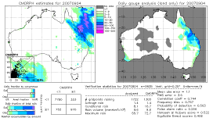
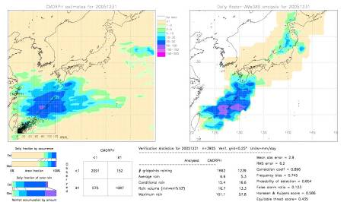
HOW GOOD? (cont.)
The IPWG is making long-term comparisons in selected regions
Satellite and model vs. gauge and radar
After Kidd; Huffman 10/10

Slide 47
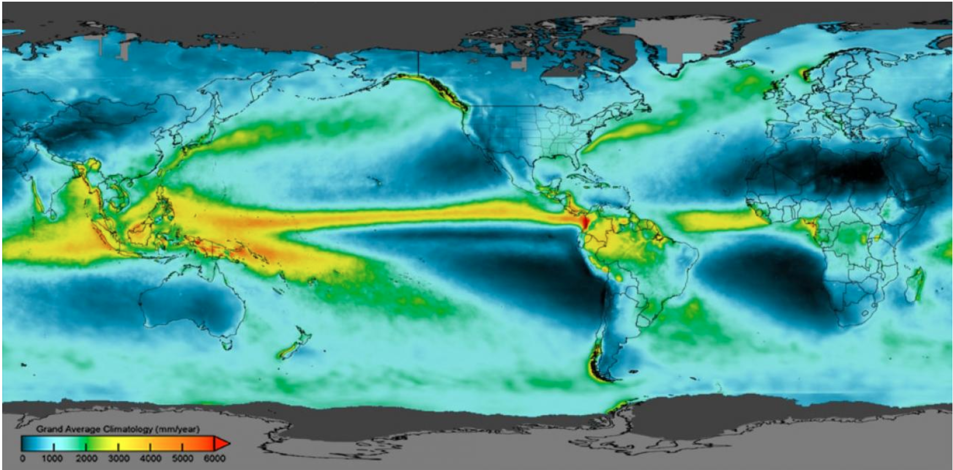
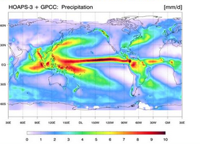
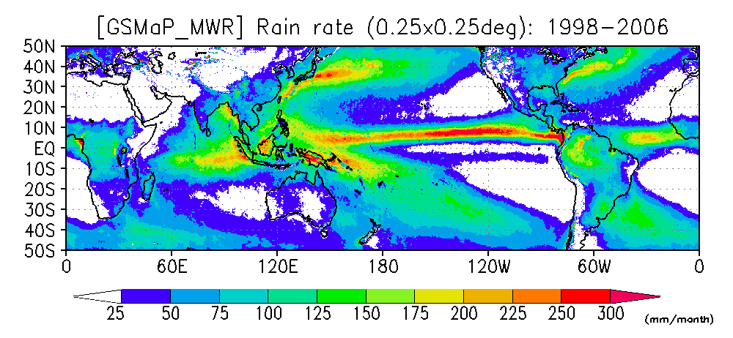
Sat/Gauge Composite Climatologies
IMERG Climatology
Kummerow,
Colorado State
Notes:
Notes: I’d show this after IMERG slides. Units are different [mm/yr, mm’month, mm/day) and color bars are different. Still, you can see that patterns are laregly similar between any of the composite products which all use microwave, IR and gauges (if available). But they are not identical because passive microwave as well as gauge input is different.

Slide 48
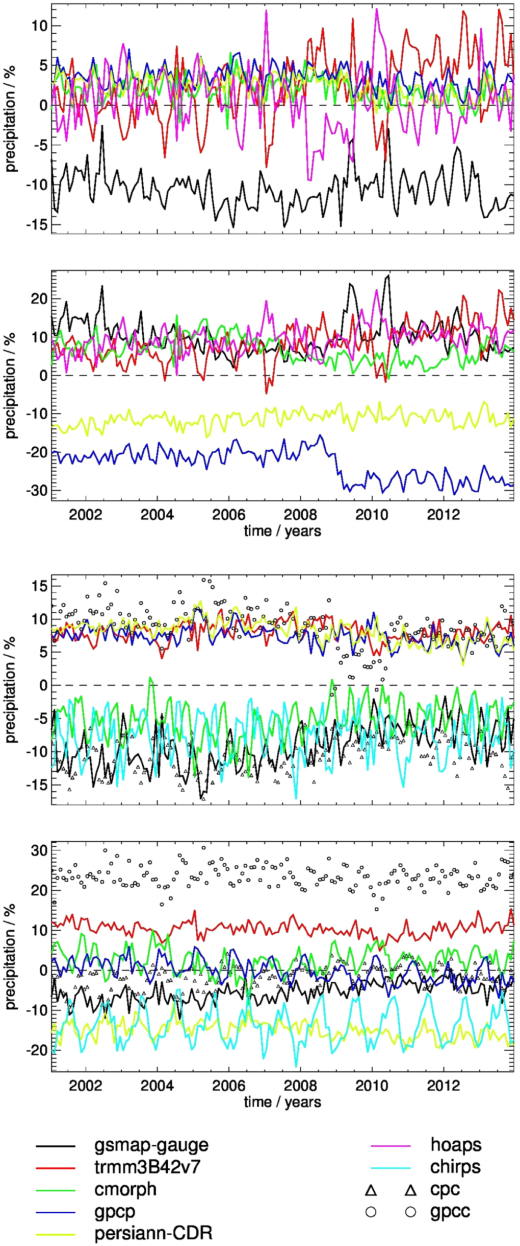
Gauges do not agree on a global scale
Mean
Extreme (99th percentile)
Kummerow,
Colorado State
From Masunaga et al., 2019
Notes:
Figure 7. Time series of anomalies relative to the ensemble mean for the period 2001–2013 for land within 50 °N/S. Note that you can GPCC (Global Precipitation Climatology Center) results – IMERG is one of them and the Climate Prediction Center ones. Extremes are also very different for both gauges and satellites due to interpolation scheme and quality of the microwave data. TRMM3B42v7 is the same as IMERG.

Slide 49
Satellite Rainfall
Microwave are superior to VIS/IR for instantaneous rain
IR estimates fare better in daily/monthly accumulation due to superior sampling and short autocorrelation times of precipitation
Merged products blend the strengths and are the most used today. Existing products are all constructed very similarly
Products use gauge adjustments if time permits
Gauge adjustments need robust statistics to avoid numerical instabilities. This limits how quickly one can adjust.
Without gauges, products tend to be only as good as microwave foundation.
Kummerow,
Colorado State
Notes:
I use this. Up to you if you want to use it.

